Slide 1

Microbenchmarks and Mechanisms For Reverse Engineering Of Modern Branch Predictor Units
Vladimir Uzelac
Master’s Thesis

Slide 2
Outline
Introduction
Thesis Goal
Motivation
Experiment Environment
Predictors Details Deconstruction
Conclusion
Notes:
Here is the outline of my presentation:
First I will make an introduction to a thesis
Next I will explain the Thesis goals
Next I will explain our motivation for reverse engineering of branch predictor units
next, I will discuss predictor details and microbenchmarks used for deconstruction
Finally, I will conclude my presentation.

Slide 3
Outline
Introduction
  Program Branches
  Branch Prediction
  Branch Target Prediction
  Branch Outcome Prediction
  Branch Predictor Design Space
Thesis Goal
Motivation
Experiment Environment
Predictors details deconstruction
Conclusion
Notes:
Branch Target Prediction
Branch Outcome Prediction – BPU must have two prediction parts.
Relatd to achieving highr prediction rates and predictor sopstications

Slide 4
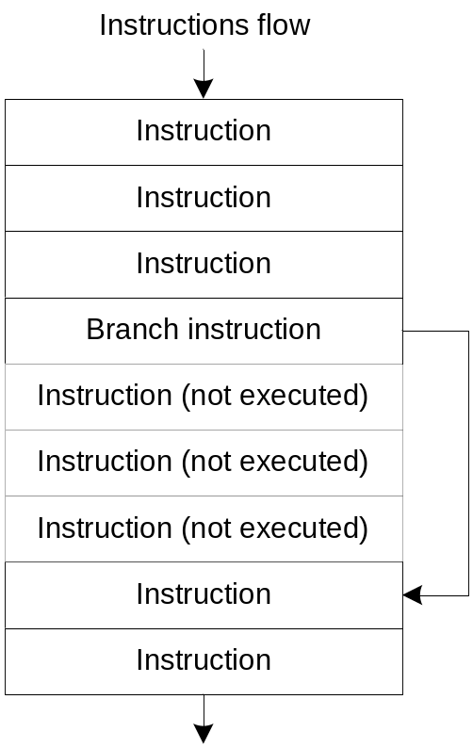
Branch Instructions
Branches may change
the instruction control flow
Type of branches
  Conditional or Unconditional
  Direct or Indirect
Branch parameters
  Branch outcome (branch will be taken or not)
  Branch target address (if taken)
Notes:
Branch instruction may change the program instruction flow (as illustrated on the picture).
The branch instruction can be classified
As conditional – we need to know both the branch outcome (taken or not taken) and the branch target address
Or Unconditional – the branch is always taken, so we need to know only the branch target address.
Further, the branches can be
Direct – the target address is known in compile-time or
Indirect – the target address is calculated in run-time.

Slide 5
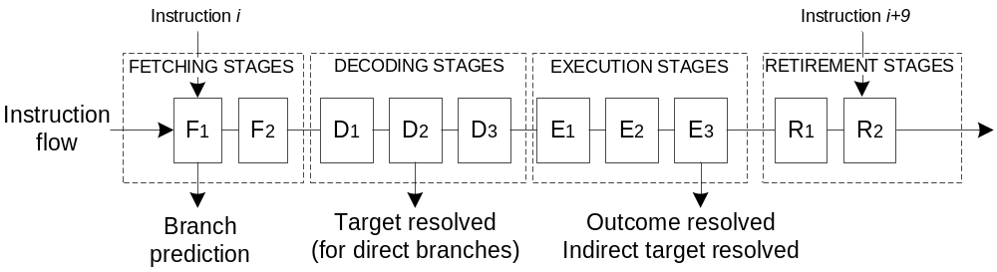
Branch Prediction
Deeper and wider pipelines
An Example
  10 pipeline stages where one instruction is at the each stage
  Upon decoding, branch target of the direct/unconditional branches known
    Penalty is 3 cycles – 3 pipeline stages flushed
  Upon execution, branch outcome/target of the indirect/conditional branches known
    Penalty is 7 cycles – 7 pipeline stages flushed
If CPI_{IDEAL} = 1 and 20% of all instructions are branches with 60% of them taken
  Consider only outcome penalty: CPI = 1+ (20% × 60% × 7) = 1.84
=> Must predict the branch outcome and the target address
in instruction fetch stage (before the instruction is decoded)
Notes:
Modern processors employ deeper pipelines (30+ in Pentium 4) and wider (fetch and execute 4-8 instruction in each clock cycle).
Here we have a single-issue processor with 10 pipeline stages
And we use this example to illustrate branch penalties.
The branch target address is known at the end of D2 stage – implying branch penalty of 3 clock cycles (for unconditional direct branches),
And the outcome and the indirect target is resolved at the end of E3 stage – which implies the branch penalty of 7 clock cycles.
Let’s assume an ideal CPI = 1 clock cycle. With 20% of branch instructions, that taken 60%., the actual CPI = 1+0.2*0.6*7 = 1.84 clock cycles –
Meaning that we achieve around 50% of the promised performance.

Slide 6
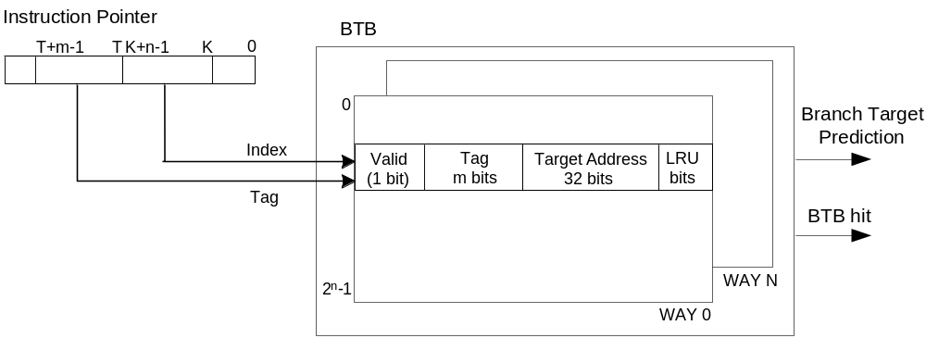
Branch Target Prediction
Instruction fetch address is used to recognize and predict a branch
Use Branch Target Buffer
  A cache-like structure containing the branch target addresses
  Indexed by a part of the IP address
  Stores partial tag
Indirect Branch Target Buffer
  A cache-like structure containing the indirect branch target addresses
  Indexed and tagged by a shift register
  containing the program path taken to reach the indirect branch

Slide 7
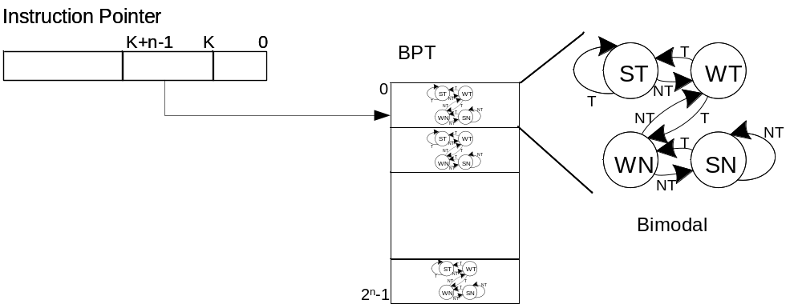
Branch Outcome Prediction
Branch Predictor Table (BPT)
  Indexed by a part of the IP address or by
  a register recording the program path taken to the branch
2-level (GShare)
  Combine branch history (kept in a BHR) with address bits
Local predictors
  Better prediction for branches with strong local correlation (e.g., loop branches)
More advanced branch predictors
  Tournament, Hybrid, Agree, Bi-mode, Yags, Gskewed, Loop Predictor

Slide 8
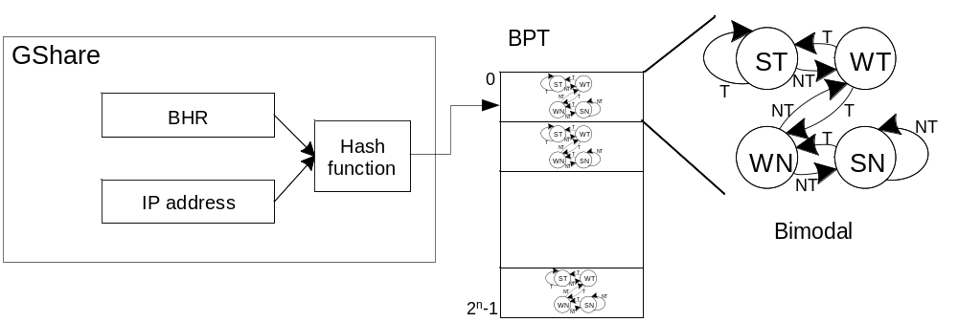
Branch Outcome Prediction
Branch Predictor Table (BPT)
  Indexed by a part of the IP address or by
  a register recording the program path taken to the branch
2-level (GShare)
  Combine branch history (kept in a BHR) with address bits
Local predictors
  Better prediction for branches with strong local correlation (e.g., loop branches)
More advanced branch predictors
  Tournament, Hybrid, Agree, Bi-mode, Yags, Gskewed, Loop Predictor

Slide 9
Branch Predictor Design Space
Goal: Achieve maximum accuracy,
with minimal cost (complexity),
latency, and power consumption
Notes:
Classify branches based on their behavior – bimodal enough for always taken, don’t put them in costly global predictor – global predictor can be smaller
cache associativity – TAG

Slide 10
Outline
Introduction
Thesis Goal
Motivation
Experiment Environment
Predictors Details Deconstruction
Conclusion

Slide 11
Thesis Goal
Develop microbenchmarks and mechanisms for reverse engineering of branch predictor units found in modern processors
  Adapt and apply the experimental flow
  to Pentium M branch predictor unit
What do we know about Pentium M?
  Target predictor: the regular BTB is augmented by an iBTB
  Outcome predictor: employs a combination of
  the Bimodal and a Global predictor augmented with a Loop predictor
What would we like to know?
  Organization and size of branch predictor structures:
  BTB, iBTB, Bimodal, Loop, and Global predictors
  Access to these structures, allocation and update policies
  Interdependencies between these structures

Slide 12
Outline
Introduction
Thesis Goal
Motivation
Experiment Environment
Predictors Details Deconstruction
Conclusion

Slide 13
Motivation
Architecture-aware compilers
  Processor become more complex –
  a large field for compilers optimizations
    Underlying architecture details are not disclosed
    Microbenchmarks extract the parameters and augment the compilers
Augment the hardware design verification process
  Changes in design may come late in the design process
  – no time for full top-level functional verification
  Microbenchmarks offer mechanism to target only
  the modified part of hardware
Bridge the gap between academia and industry
  Academia: Target predictor accuracy, rarely consider other hardware constraints
  Industry: Target timing/hardware budget constraints,
  adjust accuracy to fit in constraints

Slide 14
Presentation Outline
Introduction
Thesis Goal
Motivation
Experiment Environment
Predictors Details Deconstruction
Conclusion

Slide 15
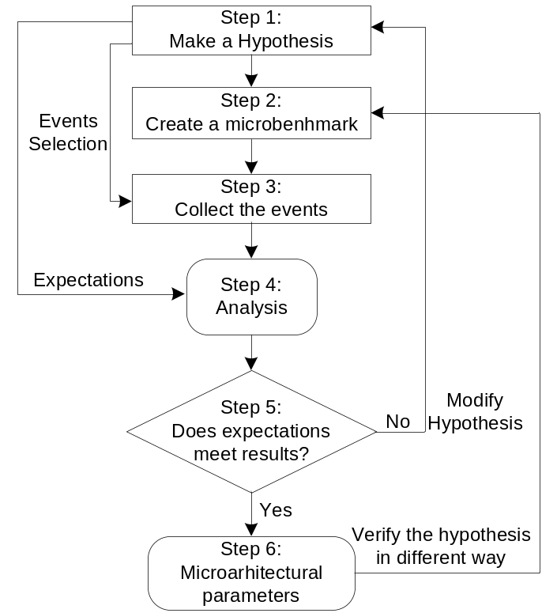
Reverse Engineering Flow
Make a hypothesis
Write microbenchmarks in C/asm, compile in VC++
  Identify the targeted parameters
  Amplify the effect of targeted parameters
  Isolate the targeted parameters
Select events of interest to be collected
using hardware performance counters
  Mispredicted branches at execution
  Mispredicted branches at decoding
  Retired Branches
  Mispredicted Indirect branches
Collect microarchitectural events
  Intel’s VTune Performance Analyzer
Compare results with the hypothesis
  If results fit, parameters extracted – try to verify parameters with an alternative benchmark
  If results do not fit, revise the hypothesis

Slide 16
Outline
Introduction
Thesis Goal
Motivation
Experiment Environment
Predictors Details Deconstruction
  Branch Target Buffer
  Loop predictor
  Indirect predictor
  Global/Bimodal predictors
Conclusion

Slide 17
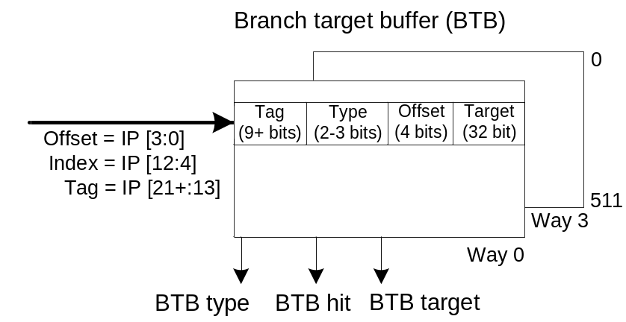
BTB Findings
BTB size/organization:
2048 entries organized 512 sets × 4 ways
Access
  Index bits are IP bits [12:4]
  Tag bits are IP bits [21+:13]
  Offset bits are IP bits [3:0]
Other findings
  Bogus branch may occur (due to partial tags); evicts whole set
  Multiple hits per set possible – offset algorithm selects the desired target from several offered
  Replacement policy is LRU based

Slide 18
BTB Tests Outline
BTB Capacity Tests
  Identify the BTB size and associativity by using the large number of branches
BTB-Set Tests
  Identify associativity, index and tag bits by using the small number of branches
Modified Capacity Test
  BTB Capacity/Set test not conclusive – verify the assumed source of inconsistence
Cache-hit BTB Capacity/Set-Tests
  Original BTB Capacity/Set Tests performed in different way
  Identify BTB size, associativity , index and tag bits
Coupled/ decoupled BTB from the outcome predictor
  Test whether the BTB stores only Taken branches – decoupled architecture.
Bogus branch
  Tests for the BTB behavior in presence of the non-branch instruction that hit in the BTB
Offset Algorithm tests
  Tests for presence of the “offset algorithm”
Notes:
“bogus branch” -because of the partial tag
“offset algorithm” – selection of proper prediction when two branches have the same tag and index but are in different part of program

Slide 19
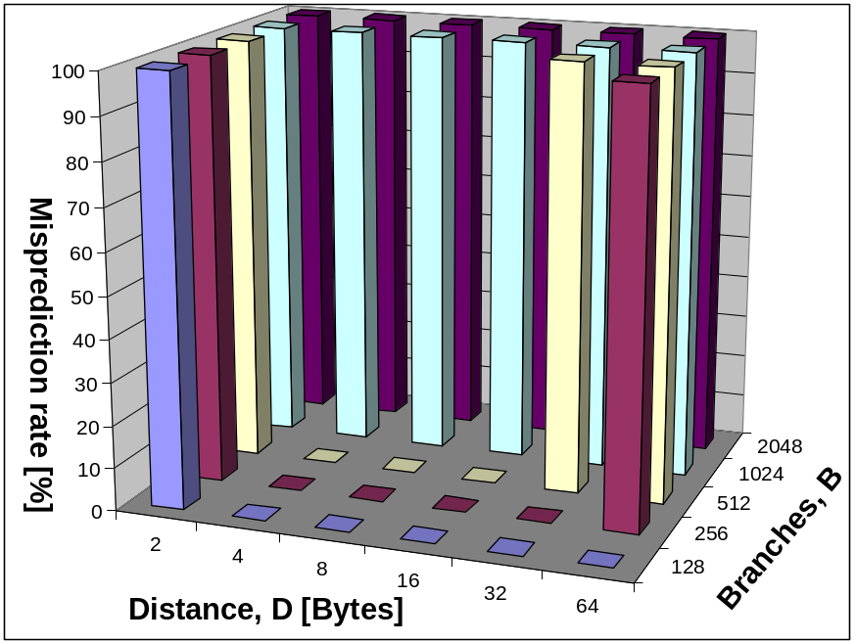
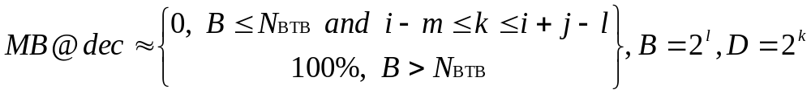
BTB Capacity Tests
A number of taken branches (B) placed at equidistant addresses in memory with distance D
Example: 4-way BTB with 512 entries, BTB index = IP[10:4]
Under certain conditions
MPR is a function of (B, D, N_{BTB}, N_{WAYS}) as described below
  m – the number of“fitting” distances D
  N_{BTB} – the number of BTB entries
  N_{WAYS} – the number of BTB ways
  j=log2N_{BTB}.

Slide 20
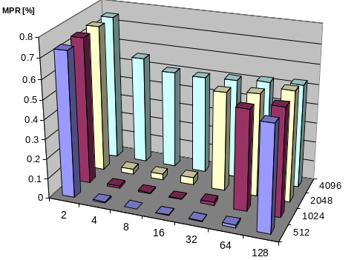
Cache-Hit Capacity Tests
Original Capacity tests are not conclusive
  Source of inconsistence is in the allocation/replacement policy
Cache-Hit Capacity Tests introduced
Cache-Hit tests stresses replacement policy
  Execution pattern
  {B₁ , B₂ ,…, B_{N}}^{k} is replaced by a new pattern:
  {B₁ , B₁ , B₂ , B₂ ,…, B_{N} , B_{N} }^{k}
  Each branch is “verified” after allocation
Results:
  4-way BTB with 2048 entries
  LRU based replacement policy
  Index = IP[12:4]
  Offset = IP[3:0]
Notes:
or may be LRU based but with changes.

Slide 21
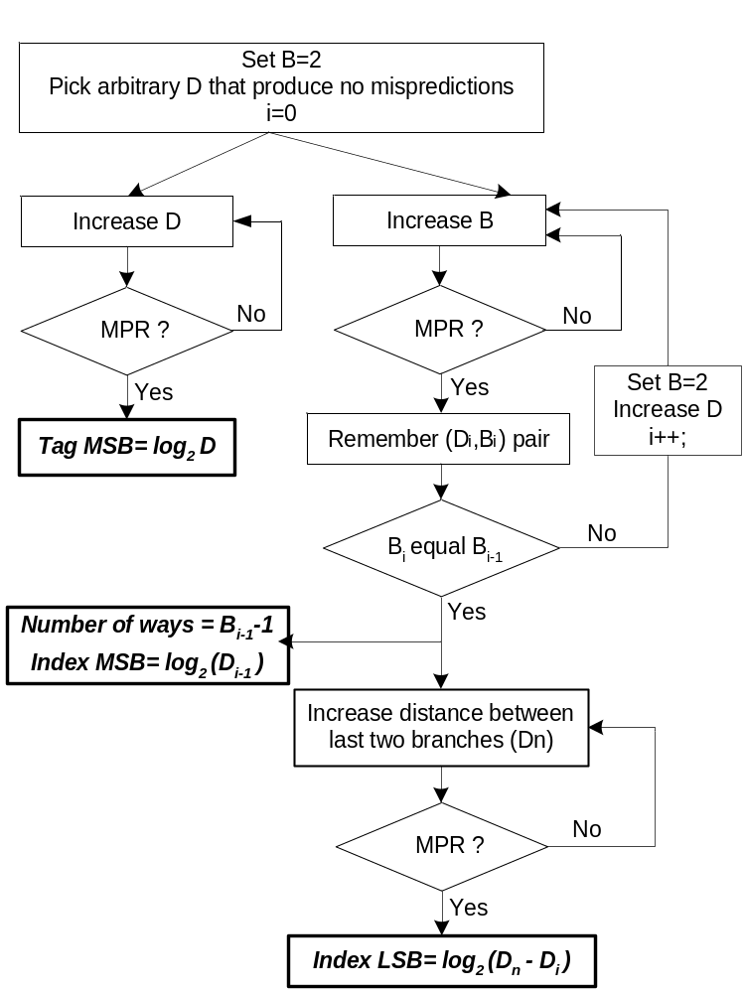
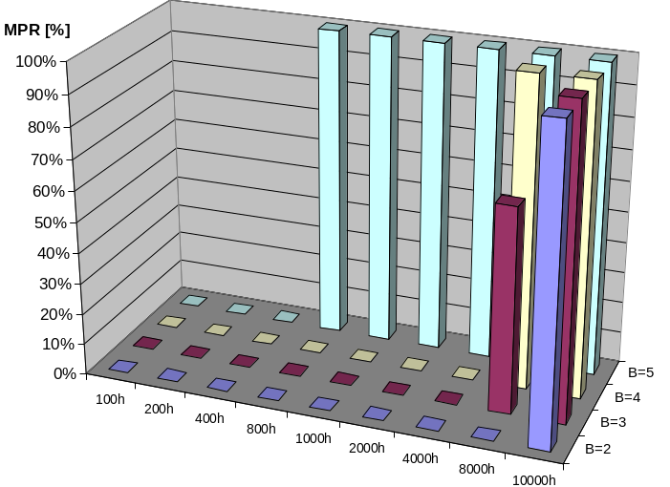
BTB-Set Tests
Determine tag and index bits, number of ways and sets
Similar to the Capacity Tests but with a smaller number of branches B placed at equidistant locations in memory with larger distances D_{S}
Under certain conditions MPR =(B, D, N_{BTB}, N_{WAYS})
Example: 4-way BTB with 512 entries
BTB index = IP[10:4], BTB Tag = IP[15:11]

Slide 22
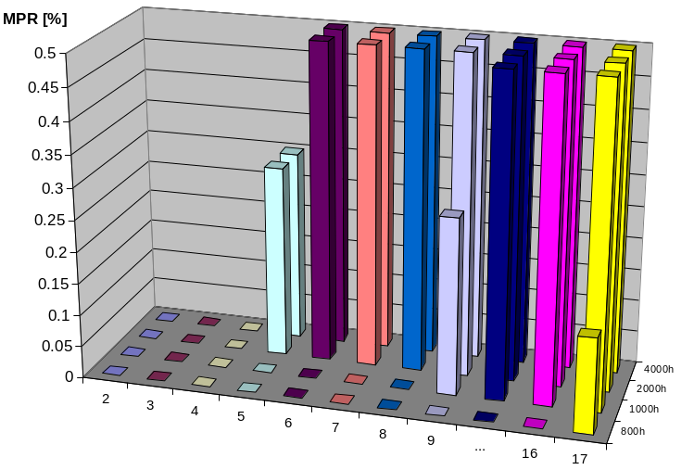
Cache-Hit BTB-Set Test
Original BTB-Set tests are not conclusive
  Source of inconsistence is in the allocation/replacement policy
  3 or 4 branches that hit in the same set of the 4-way BTB cause mispredictions
Cache-Hit BTB-Set tests introduced similar as the Cache-Hit Capacity tests
  Execution pattern: {B₁ , B₁ , B₂ , B₂ ,…, B_{N} , B_{N} }^{k}
Results:
  Index MSB bit = IP[12]
  Index LSB bit = IP[4]
  Tag MSB bit = IP[21]
  4-ways
  LRU replacement policy
Notes:
For D – 800h to 2000h, Mispredictions occurrence point changes with B.
Ideal algorithm would give at least one misprediction per iteration, LRU even B

Slide 23
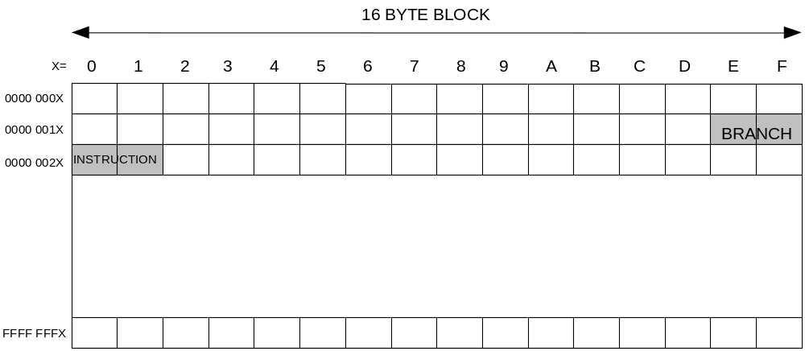
Offset Algorithm Test
How to predict the branch based on IP only?
Instructions are fetched block by block (16-byte instruction block)
Don’t know branch IP until decoding – current IP point to block start position
  Make an BTB hit for each Tag match and Offset > IP
Offset algorithm selects the prediction with the lowest offset yet not smaller than the IP
Microbenchmark proves the existence of the offset algorithm

Slide 24
Presentation Outline
Introduction
Thesis Goal
Motivation
Approach
Predictors details deconstruction
  Branch Target Buffer
  Loop predictor
  Indirect predictor
  Global/Bimodal predictors
Conclusion
Notes:
Here is the outline of my presentation:
First I will explain our motivation to study hardware techniques for ensuring code integrity.
next, I will give a short overview of techniques to counter code injection attacks.
Then I will introduce a common mechanism for instruction block verification and its 4 implementations.
After that I will explain the experimental methodology and present evaluation results.
Finally, I will conclude my presentation.

Slide 25
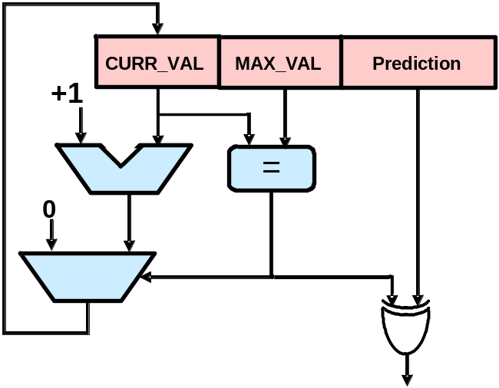
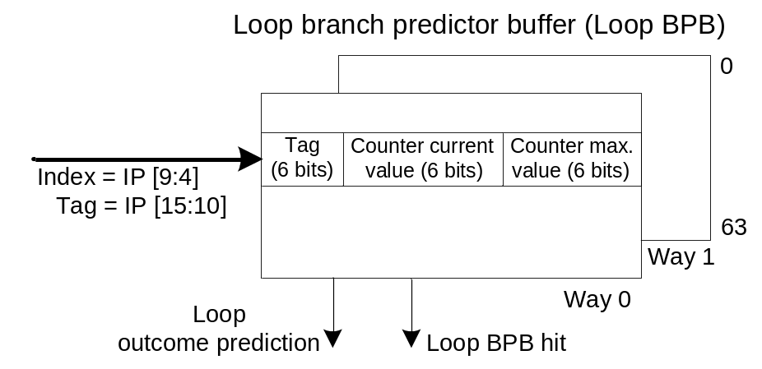
Loop Predictor Findings
A cache structure named loop branch predictor buffer (Loop BPB)
has two 6-bit counters in one cache entry
Counter MAX_VAL stores the loop branch maximum count value
Counter CURR_VAL stores the loop branch current iteration number
Loop BTB is a two way structure organized in 64 sets
  Index by the IP address bits [9:4]
  Tag bits are IP address bits [15:10]

Slide 26
Loop Predictor Tests Outline
Loop counters size test
  Identifies the loop maximum count value that predictor may count – size (in bits) of the CURR_VAL and MAX_VAL counters
Loop BPB Capacity tests
  Identifies the Loop BPB size and associativity by using large number of loops
Loop BPB-Set tests
  Identifies the Loop BPB associativity, index and tag bits by using small number of loops
Loop branch training tests
  Check whether the loop training process (obtaining MAX_VAL)
  takes place in the loop BPB or in a separate structure
Loop branch allocation test
  Test for the branch outcome behavior that makes the branch to be allocated in the loop BPB
Loop BPB relations with the BTB test
  Test whether the loop predictor hit is conditional upon the BTB hit
Loop BPB replacement policy test
Local predictor existence check
Notes:
Here is the outline of my presentation:
First I will explain our motivation to study hardware techniques for ensuring code integrity.
next, I will give a short overview of techniques to counter code injection attacks.
Then I will introduce a common mechanism for instruction block verification and its 4 implementations.
After that I will explain the experimental methodology and present evaluation results.
Finally, I will conclude my presentation.

Slide 27
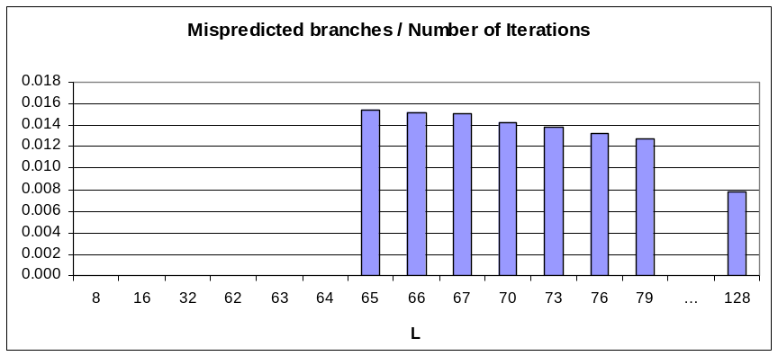
Loop Counters Size Test
Microbenchmark design
  Have a “spy” loop branch with variable pattern length L, placed in a loop with I iterations
  Observe misprediction rate
    Should be zero as long as
    L ≤L_{MAX}
    Should be I/L when L > L_{MAX}
Results
  L_{MAX} = 64 =>
  counter length is 6 bits
#define L 65 /* pattern length */
void main(void){
int long unsigned i; /* loop index */
int long unsigned I = 100000000; /* number of iterations */
for (i=0; i<I; ++i){
if ((i%L) == 0) a=0; /* spy branch */
}
}

Slide 28
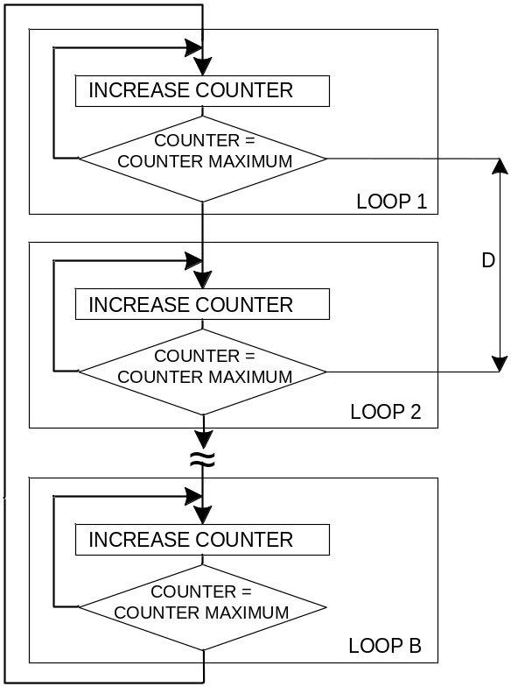
Loop BPB Capacity Tests
Similar to the BTB Capacity tests
Employs B loops at the distance D from each other
BTB Capacity equations applies here too
Notes:
Loops – a branch with associated instructions to make a loop

Slide 29
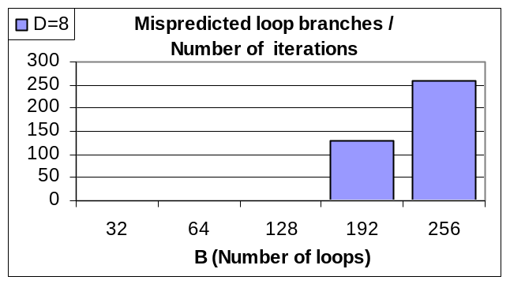
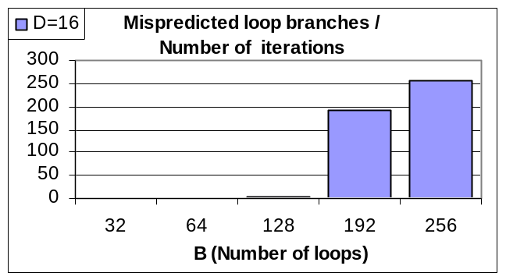
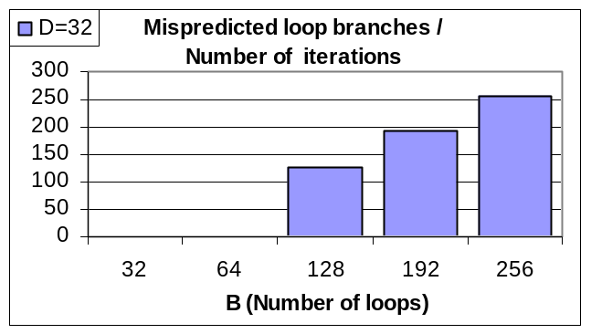
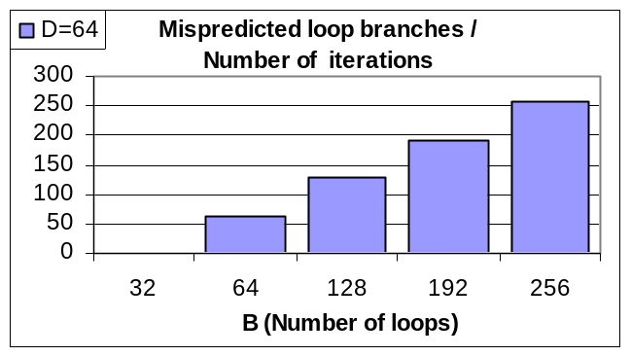
Loop BPB Capacity Tests Results
When D=8 and D=16 and B > 128, MPR exist,
for B=256, all loops are mispredicted
  Loop BTB size is 128 entries
  Minimum number of ways is two
For D=32 => BMAX(no MPR) = 64, for D=64 => BMAX(no MPR) = 32

Slide 30
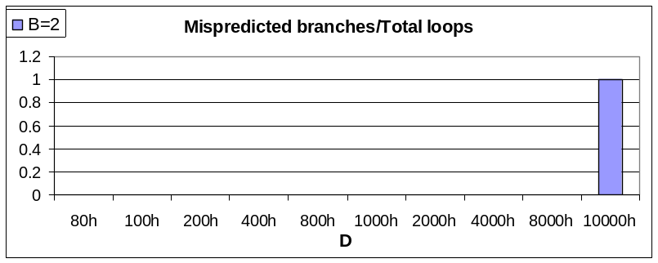
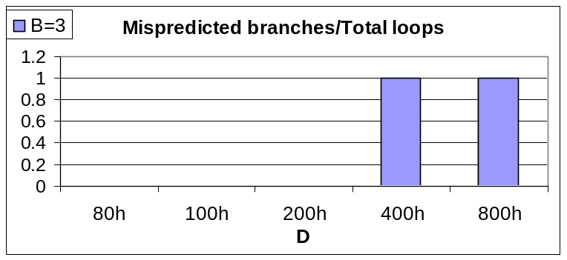
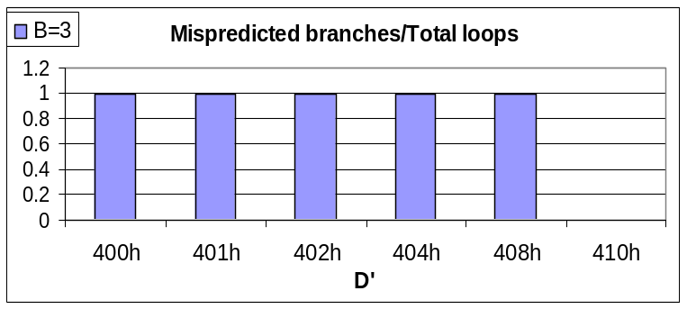
Loop BPB-Set Tests
Similar like BTB-Set test
  Employs B loops at the distance D
  Observe MPR as a function of D and B
Results
  Tag MSB bit is the IP bit [15]
  Index MSB bit is the IP bit [9]
  Index LSB - distance D’ between 2nd and 3rd branch is increased.
    Index LSB bit is the IP [4]
  Number of ways is 2 (64x2)

Slide 31
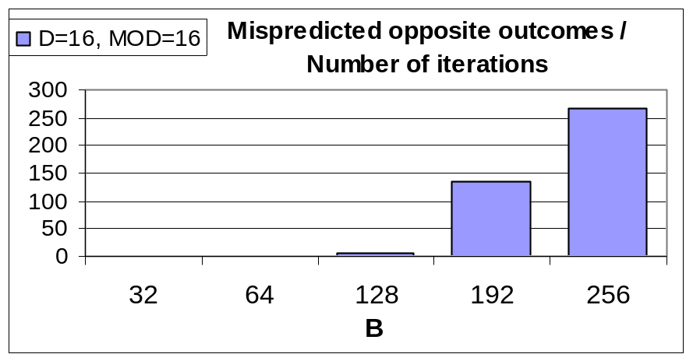
Loop Branch Training Tests
MAX_VAL counter must be set before loop prediction can work
Two ways to set MAX_VAL
  Training done in Loop BPB after branch allocation
    Shortcoming – Evicts existing entry but new branch may come out not to be loop
  Training out of the Loop BPB – after branch is a candidate for a loop,
  it is allocated in the training logic
    Shortcoming – Additional hardware used
Test: similar to BTB Capacity test but branches with loop branches
  All are in training at once – evict each other when B > training logic size
Results:
128 branches may be trained at once
(training is done in the LBPB)

Slide 32
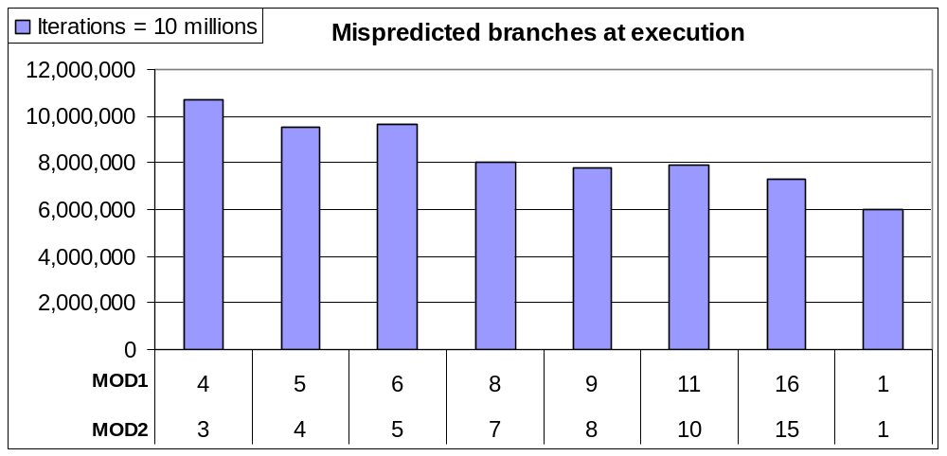
Loop Branch Allocation Test
Assumption 1: Loop Like allocation
  Allocate a branch in the loop BPB if the branch opposite outcome is detected
  Non-loop branch may be allocated: T, T, …T, nT, nT, T, T,… - allocation on nT
Assumption 2: Real loop allocation
  Allocate a branch in the loop BPB if the real loop is detected
  Non-loop branch not allocated: T, T, …T, nT, nT, T, T,… - loop not verified
Test: Put branch {3*T, 2*nT} in the same set with two loops
  If loops are evicted - MPR proportional to the 1/(loop1 mod) + 1/(loop2 mod) T
Results:
  Loop-Like allocation
Notes:
Case1 – non loop branch allocated

Slide 33
Loop BPB Replacement Policy Test
Two way structure – one replacement bit
  LRU replacement policy – flip the bit on both loop BPB hit and miss
  FIFO replacement policy – flip the bit on loop BPB miss only
Test: Three branches A,B,C have occurrence pattern: A,B,A,C,A,B,A,C
  LRU – Misprediction 50%
  FIFO – Misprediction 100%
Results: Misprediction 50%
  LRU policy

Slide 34
Outline
Introduction
Thesis Goal
Motivation
Approach
Predictors details deconstruction
  Branch Target Buffer
  Loop predictor
  Indirect predictor
    Path information register details (PIR)
    Indirect predictor cache access function details
    Indirect predictor cache organization
  Global/Bimodal predictors
Conclusion
Notes:
Here is the outline of my presentation:
First I will explain our motivation to study hardware techniques for ensuring code integrity.
next, I will give a short overview of techniques to counter code injection attacks.
Then I will introduce a common mechanism for instruction block verification and its 4 implementations.
After that I will explain the experimental methodology and present evaluation results.
Finally, I will conclude my presentation.

Slide 35
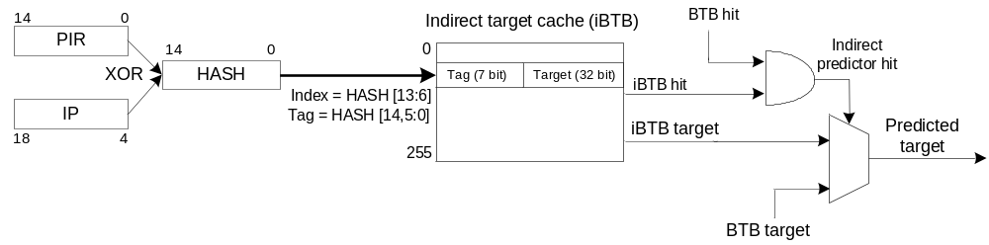
Indirect Predictor Findings
A direct-mapped cache structure with 256 entries named iBTB stores indirect branches targets
  Accessed with the path information register( the PIR) XOR-ed with the indirect branch IP address
  iBTB hit conditional upon BTB hit – BTB better identifies the branch occurrence
PIR Organization
  Width – 15 bits
  Affected by the 15 bits of the conditional taken branch IP address
  Affected by the 15 bits combined from the indirect branch IP address and the indirect branch target address.
  PIR is shifted for two bits left prior to update (XOR) with the newly occurred program branch.
  PIR History depth = 8
iBTB access function
  XOR between part of the indirect branch IP address bits and the PIR
  Resultant 8 bits are used as the index, 7 bits as the tag in the iBTB
Notes:
PIR contains information from branches on the executed path

Slide 36
Indirect predictor tests outline
PIR organization tests
  Path- or pattern based PIR – determines whether the PIR is affected by the conditional branch target address or the IP address
  Conditional branch IP address effect on PIR - Which bits of the conditional branch IP address affect the PIR, PIR history length, PIR shift count and the PIR width
  Indirect branch IP and target address effect on PIR - Which bits of the indirect IP address and target address affect the PIR and the way they are XOR-ed with the PIR
  Branch type effect on PIR - what branch types affect the PIR
  (tested: Cond. NT branches, Call/ret, unconditional)
  Branch outcome effect on PIR – Does the outcome of the branch affects the PIR
Indirect branch IP effect on iBTB access hash function –
Determines which Indirect branch IP bits affect the iBTB access hash function
iBTB access hash function - Which Indirect branch IP and PIR bits are XOR-ed
iBTB organization – Hash function Tag and Index in the iBTB. Number of ways in the iBTB
iBTB relations with the BTB – iBTB hit conditional upon BTB hit
Notes:
Here is the outline of my presentation:
First I will explain our motivation to study hardware techniques for ensuring code integrity.
next, I will give a short overview of techniques to counter code injection attacks.
Then I will introduce a common mechanism for instruction block verification and its 4 implementations.
After that I will explain the experimental methodology and present evaluation results.
Finally, I will conclude my presentation.

Slide 37
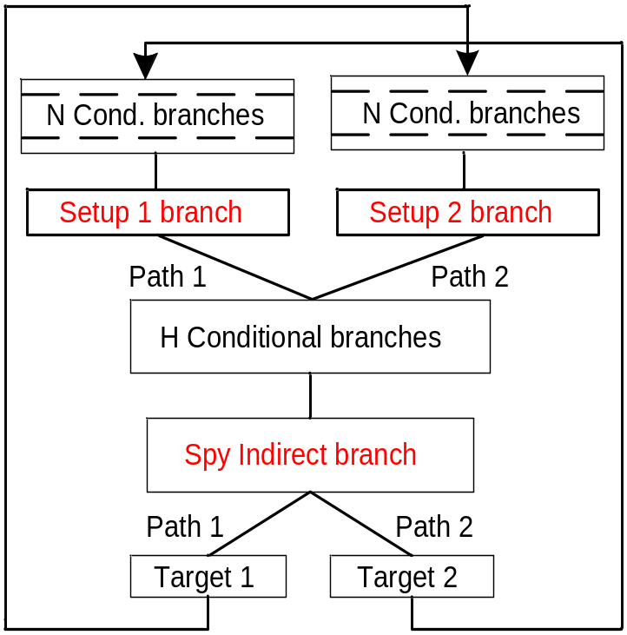
PIR Organization –
Conditional Branches IP Effect on PIR
Find conditional IP bits used for the PIR, PIR history length, shift count and the PIR width
Spy branch has two targets that alternate
Each target preceded by the different path – PIR values are different
  Setup0 and Setup1 make PIR values different
  Setup0 and Setup1 differ in only one bit – k = log₂D
If the bit k affects the PIR, Target1 and Target2
are allocated in different iBTB entries – MPR low
H block move Setup0 and Setup1 further into the PIR
  For large H - Path1 = Path2
  Mispredictions occur regardless the k
Analysis of MPR as a function of H and D
give answer to the questions
Notes:
For large H - Path1 = Path2 - Setup0 and Setup1 do not affect the Spy’s PIR

Slide 38
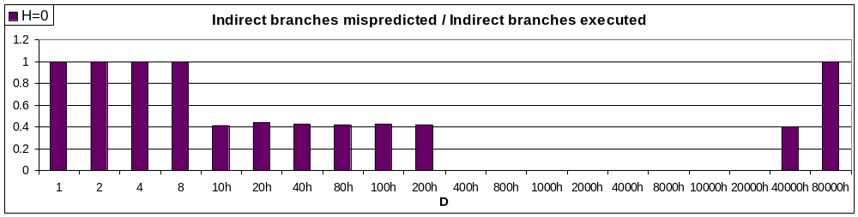
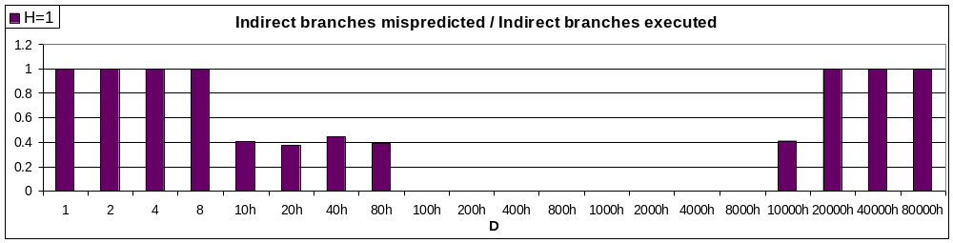
PIR organization – Conditional Branches IP Effect on PIR Test Results
H=0: Branch address bits used for the PIR – IP [18:4]
  PIR length is 15 bits, conditional branch IP[18:4] XOR-ed with the PIR[14:0]
  Some bits have MPR of 40% - indication on direct-mapped cache
For H=1, 15 bits used, for H=1, 13 bits used => PIR shift count = 2
Notes:
H=0 case is important because conditional branch is not yet shifted in the PIR – results can be translated to PIR results
MPR of 40 – if branches target different sets MPR should be 0% as for other bits (iBTB hit/correct prediction)
- if branches target the same set MPR should be 100% as for other bits (iBTB hit/misprediction)
- iBTB miss occurred (iBTB miss)

Slide 39
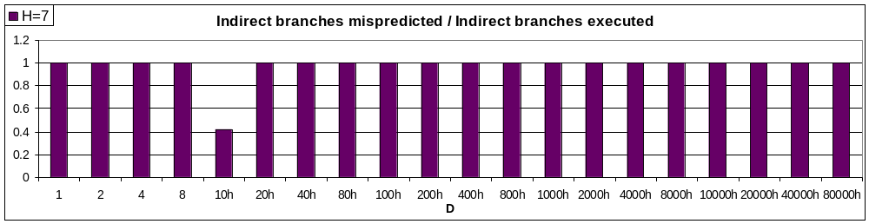
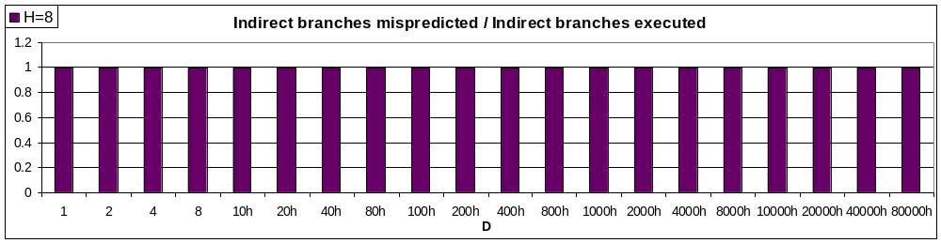
PIR organization – Conditional Branches IP Effect on PIR Test Results (cont’d)
Up to H=7 possible without mispredictions for all D values
  Obviously, for H=8, all bits that influence the PIR are shifted out of the PIR
  PIR history length is 8 branches

Slide 40
PIR Organization – Indirect Branches Types Effect on PIR Test
Setup1 and Setup2 replaced with
other types of branches
Same algorithm performed –
set D distance (D=2^{k}) between Setup1 and Setup2
IP addresses or target addresses:
Results:
  IP[18:12] concatenated with TA[5:0] and
  XOR-ed with the PIR
  Unconditional, Conditional Not taken and Call/Returns
  branches do not affect the PIR

Slide 41
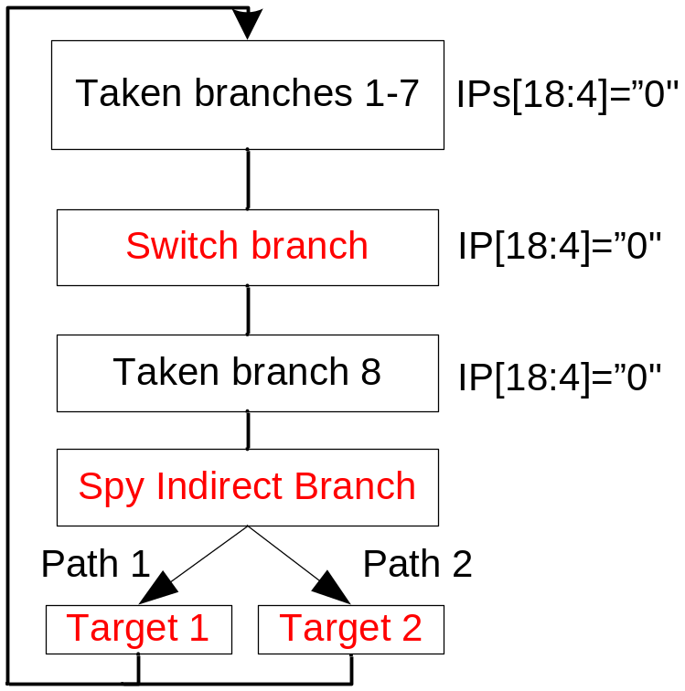
PIR Organization –
Branch Outcome Effect on PIR Test
Switch has nT outcome for Target1, T for Target2
Two Paths created:
  Path to the Taget2: <Taken branch 8, Switch, Taken branches 7-1>
  Path to the Taget1: <Taken branches 8 -1>
All Switch and Taken branches
IP bits [17:4] are the same
  PIR values different only if outcome
  affects the PIR- MPR low
Result: MPR high –
Branch outcome do not affect the PIR
Notes:
Misprediction low if the branch outcome affects the PIR
Path are different only if outcome affects the PIR

Slide 42
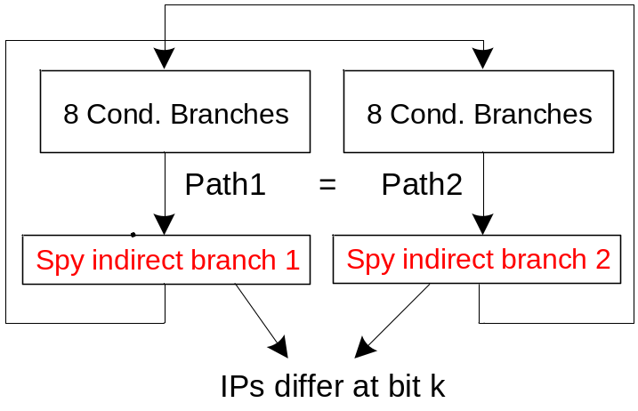
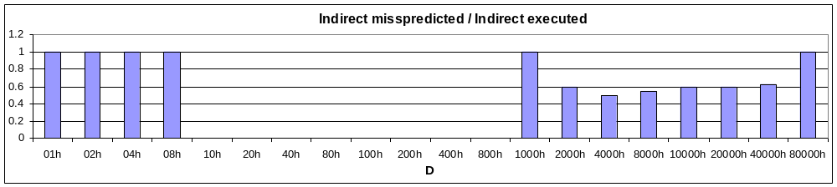
Indirect Branch IP Effect on iBTB Access Hash Function Test
Two Spy branches used
  Each has two targets and two different paths
  Two paths just to avoid prediction from the BTB
Spy branches set at distance D, D=2^{k}
  If bit k affects the iBTB access function -
  MPR is zero
Results:
Indirect branch IP[18:4] used, with anomaly on 12 bit

Slide 43
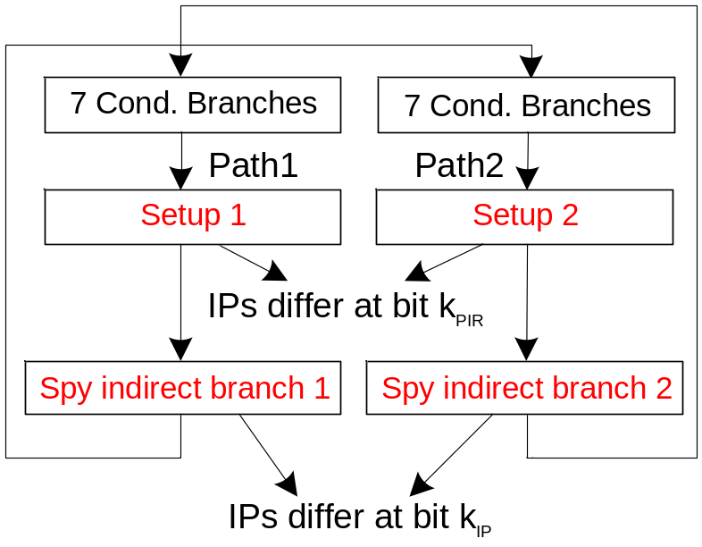
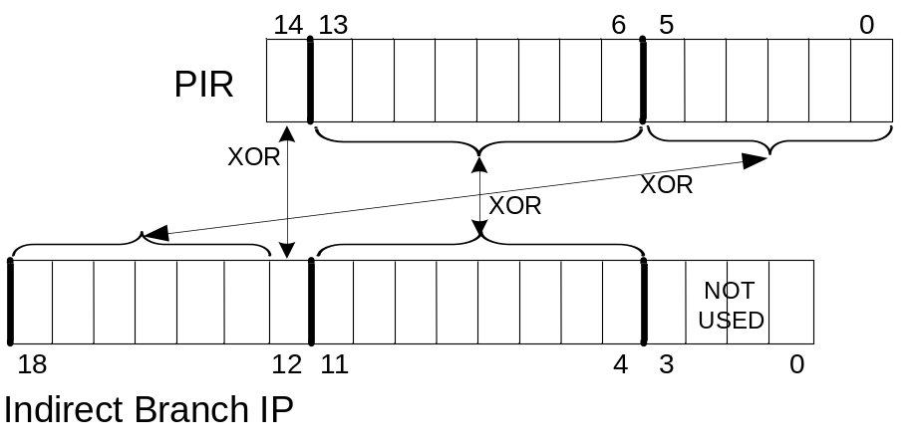
iBTB Access Hash Function Test (cont’d)
Find which PIR and indirect branch IP bits are XORed in the iBTB access hash function
Similar approach as in the previous test
  Spy branches set at distance D_{IP}, D=2^{kIP}
Set PIR values for Path2 and Path1
to be different at bit k_{PIR}
If the bit k_{IP} and the bit k_{PIR} XOR in the hash function, Path1 = Path2 and MPR exist
Results:
  IP[18:12] xor PIR[5:0]
  IP[11:4] xor PIR[13:6]
  IP[12] xor PIR[14]

Slide 44
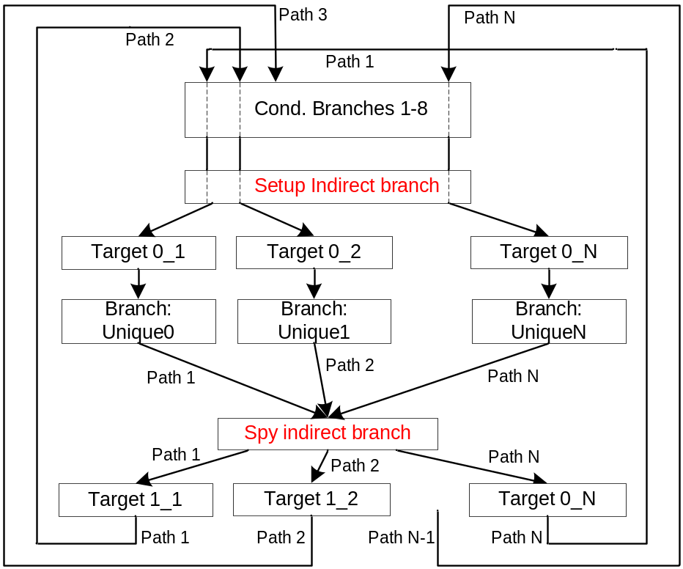
iBTB Organization Test
Find tag and index bits in the iBTB, find number of the iBTB ways and sets
Setup branch creates N Unique branches – N unique paths to the Spy branch
  Unique branches are
  at distance D from each other
  If Unique branches differ at tag bits
  only and N > # of ways MPR exist
  If Unique branches differ at index bits
  also – MPR is a function of D and N
MPR = f(D,N) sufficient to answer the
questions
Results:
  From D=400h N < 256 without MPR –
  iBTB size 256 entries
  Index = HASH[13:6]
  Tag = HASH[14, 5:0]
Notes:
Find tag and index bits in the iBTB – From Hash function

Slide 45
Outline
Introduction
Thesis Goal
Motivation
Approach
Predictors details deconstruction
  Branch Target Buffer
  Loop predictor
  Indirect predictor
  Global/Bimodal predictors
    Branch history register details (BHR)
    Global access function details
    Global predictor cache organization
    Bimodal table size and indexing
Conclusion

Slide 46
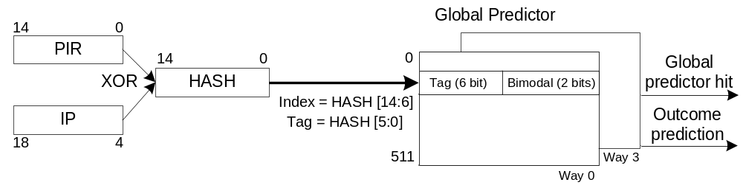
Global Predictor Findings
A 4-way cache structure with 2048 entries
Accessed with the hash function - PIR XOR conditional branch IP
  Resultant 9 bits are used as the index, 6 bits as the tag in the Global predictor
PIR Organization
  PIR is the same PIR as the iBTB PIR

Slide 47
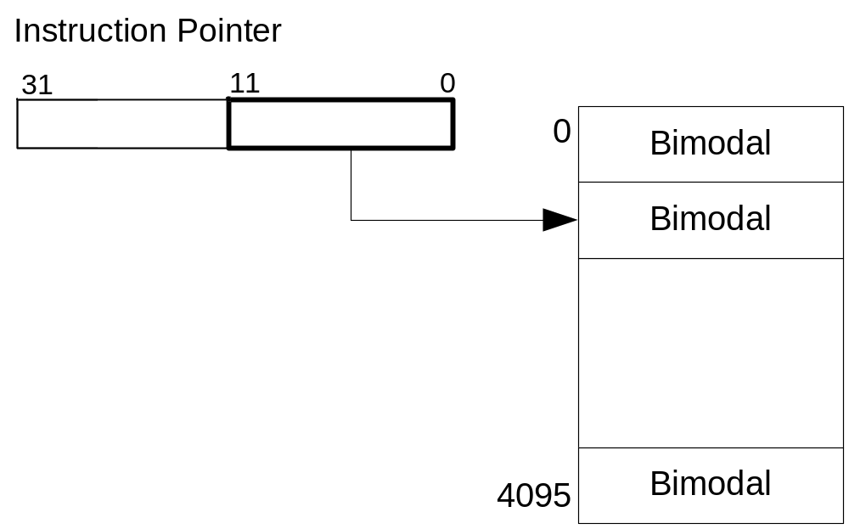
Bimodal Predictor Findings
A table of Bimodal counters – 4096 counters
Indexed by the IP address bits [11:0]

Slide 48
Global/Bimodal Predictors Tests Outline
BHR Organization Tests
  Conditional branch IP address effect on BHR - Which bits of the conditional branch IP address affect the BHR, BHR shift count and the BHR width
  Indirect branch IP and target address effect on BHR - Which bits of the indirect IP address and target address affect the BHR and the way they are XOR-ed with the BHR
  Branch type effect on BHR - What branch types affect the BHR( tested: Cond. NT branches, Call/ret, unconditional.)
  Branch outcome effect on PIR - Does the branch outcome effects the BHR
Global predictor access hash function –
Which Conditional branch IP and BHR bits are XOR-ed
Global predictor organization - Hash function Tag and Index in the Global predictor. Number of ways and sets in the Global predictor
Bimodal predictor organization – What are the Index bits and the Bimodal predictor size
Global-Loop predictors relations
  Which hit has the priority
Notes:
Here is the outline of my presentation:
First I will explain our motivation to study hardware techniques for ensuring code integrity.
next, I will give a short overview of techniques to counter code injection attacks.
Then I will introduce a common mechanism for instruction block verification and its 4 implementations.
After that I will explain the experimental methodology and present evaluation results.
Finally, I will conclude my presentation.

Slide 49
Branch IP/target effect on BHR
Tests for IP/TA performed similar to the iBTB tests
Indirect branch w/ 2 targets replaced with the conditional branch with two outcomes
BHR affected in the same way as the PIR
  BHR is PIR – only one history register used
Notes:
Here is the outline of my presentation:
First I will explain our motivation to study hardware techniques for ensuring code integrity.
next, I will give a short overview of techniques to counter code injection attacks.
Then I will introduce a common mechanism for instruction block verification and its 4 implementations.
After that I will explain the experimental methodology and present evaluation results.
Finally, I will conclude my presentation.

Slide 50
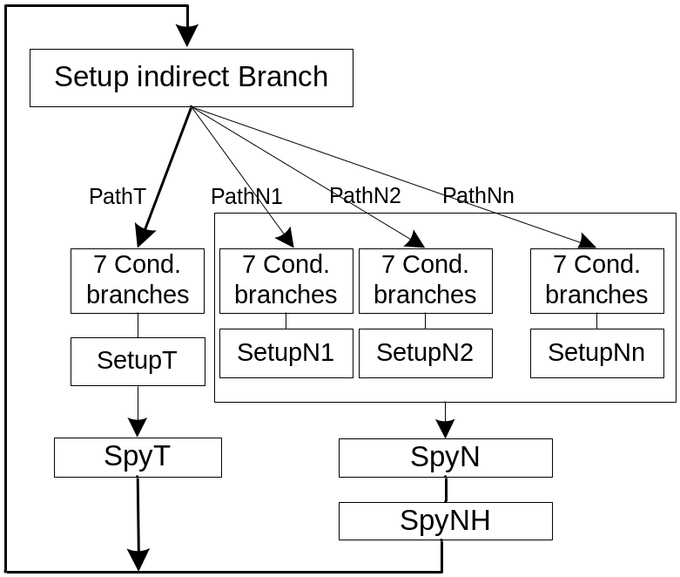
Global Predictor Organization Test
Produce contention in the Global predictor set
Prediction relies on the Bimodal predictor –
set to give mispredictions
Test: one Taken and one Not Taken branch
(SpyT and SpyN)
  SpyT distance from SpyN is large –
  target the same Bimodal entry
One path to the SpyT and N paths to the SpyNT
  Paths occurrence pattern:
  T*PathT, PathN1, T*PathT PathN2, …, T*PathT, PathNN, T*PathT, PathN1 …
  Global predictor sees SpyN as the N different branches
Difference in paths to SpyN achieved by setting
SetupNi branches at distance D_{G} from each other. D_{G} =2^{k}
MPR = f (D_{G} and N) sufficient to determine global predictor organization
(index, tag bits, number of ways and size)

Slide 51
Global Predictor Organization Test Results
Results: Results inconsistent similar as for the BTB tests
  Use the Cache-hit BTB tests approach: Each PathNi executed twice consecutively:
T*PathT, PathN1, T*PathT, PathN1, T*PathT, PathN2, T*PathT, PathN2, ... ,
T*PathT, PathNN, T*PathT, PathNN,
Cache-Hit results:
  For N=3, 4 - MPR = 0 regardless of D
  For N=5, MPR exist for D_{G} <100h => 4-way structure
  Index = HASH[13:6]
  Tag = HASH[5:0]
Notes:
Not all PIR bits checked as it is not important – Dg can not checke if some upper bit is used for the Index

Slide 52
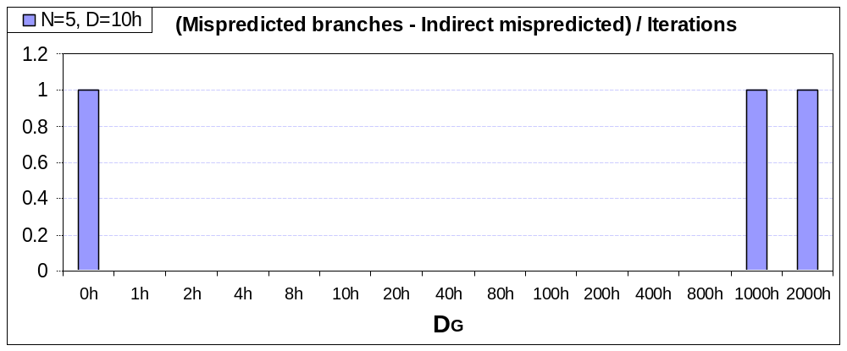
Bimodal Predictor Organization
Reuse the previous test – make contentions in Global predictor (N=5)
Make the branch correctly predicted by Bimodal
  Set the distance D_{G} between SpyN and SpyT; D_{G} =2^{k}
    Contentions in Global predictor still exist
    No contentions in Bimodal Predictor if bit k used for Bimodal Index
Results:
  Bimodal Index bits – IP[11:0]
  Bimodal size – 4096 entries

Slide 53
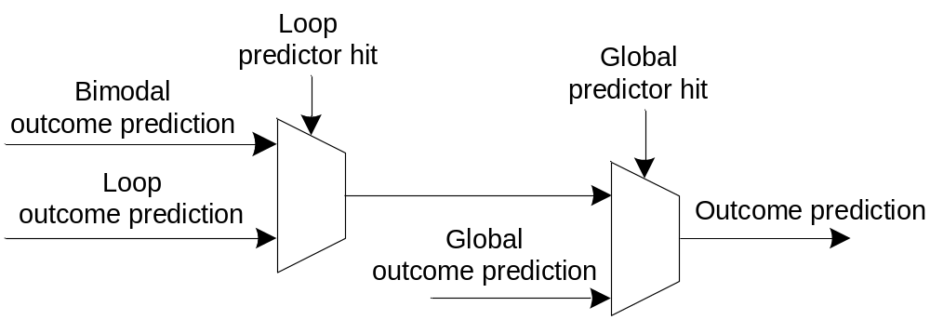
Global-Loop Predictors Relations
Which hit has priority: Global hit or the Loop Hit?
Test:
  Make a branch that will produce hit and misprediction in Loop predictor
  Same branch produces hit and correct prediction in the Global Predictor
Branch pattern: T T T nT T T T nT T T T nT nT
Results: No mispredictions – Global hit overrides Loop hit
Loop allocated
MAX_VAL set
Loop BPB misprediction
Global Predictor correct prediction
Notes:
Global Predictor correct prediction – because of the Unique path

Slide 54
Outline
Introduction
Thesis Goal
Motivation
Approach
Predictors details deconstruction
Conclusion

Slide 55
Conclusion and Future Work
Branch predictor unit - crucial resource that achieve higher performances
This thesis presented
  Systematic approach to reverse engineering of modern branch predictor units.
  Microbenchmarks specially crafted for Intel’s Pentium M processor
  We found five predictor structures
    Branch Target Buffer - BTB
    Indirect Target Buffer
    Loop Predictor
    Global Predictor
    Bimodal Predictor
  A basis for reverse engineering of different parameters
  Future Work
    Extend the work on the other branch predictor units
    Automatic generation of microbenchmarks
    Hopefully, industrial collaboration for hardware verification microbenchmarks
Notes:
Global Predictor correct prediction – because of the Unique path

